Slide 1
Getting Started

Slide 2
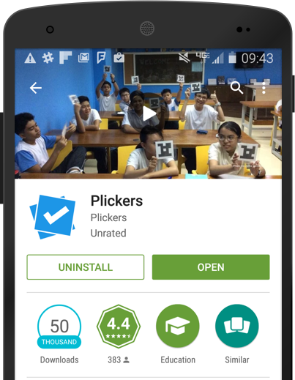
Download the App
In order to scan students' responses, you must have the Plickers mobile app installed.
Plickers is available for free on
Only the teacher needs the Plickers App. Students don’t need to download a thing!
For the iPad, filter by "iPhone only" and search for Plickers in the App store.

Slide 3
Print Your Cards
Print out your cards from plickers.com/cards or purchase a set on Amazon.com.
Each card has a unique number that can be assigned to individual students.
Each side represents an answer choice.

Slide 4
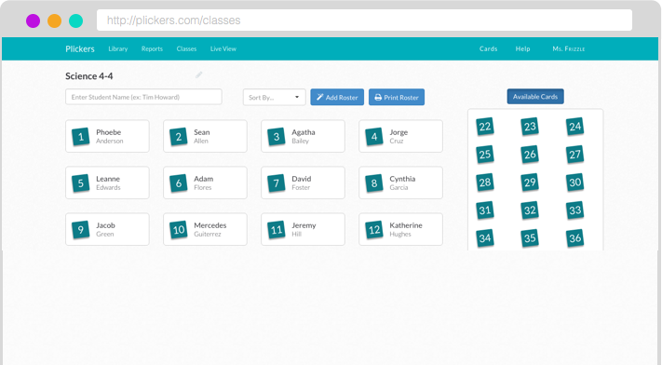
Add Your Class
Add classes and students through the Plickers website on the Classes page.
Plickers automatically assigns card numbers to students as you enter their names.
Add up to 63 students per class.

Slide 5
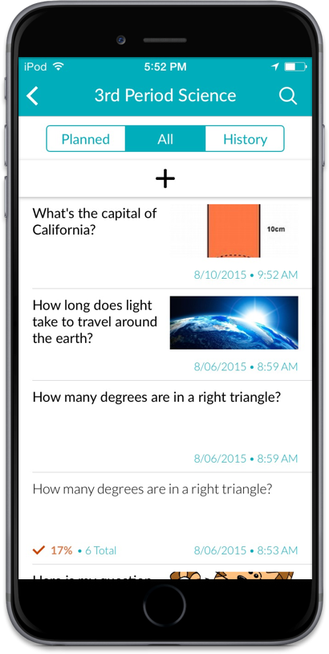
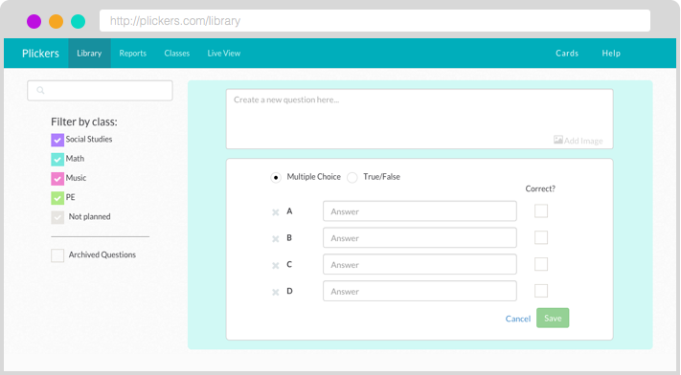
Add Your Questions
Create new questions in your Library on the web or on your mobile app using the “+” icon.
Choose from multiple choice or true/false questions.
Include images in your questions.

Slide 6
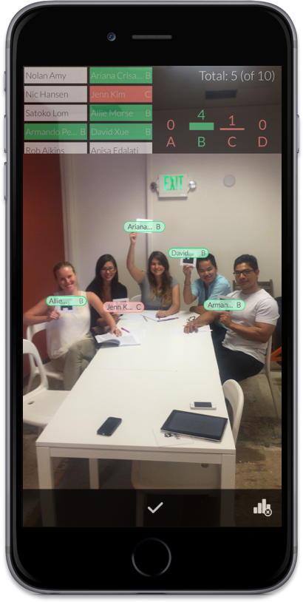
Scan Responses
Select the question you want to use on the mobile app.
Tap the camera icon to scan students’ responses and receive instant feedback on their answers.
Use the Live View tab on the website to display classroom results to students.

Slide 7
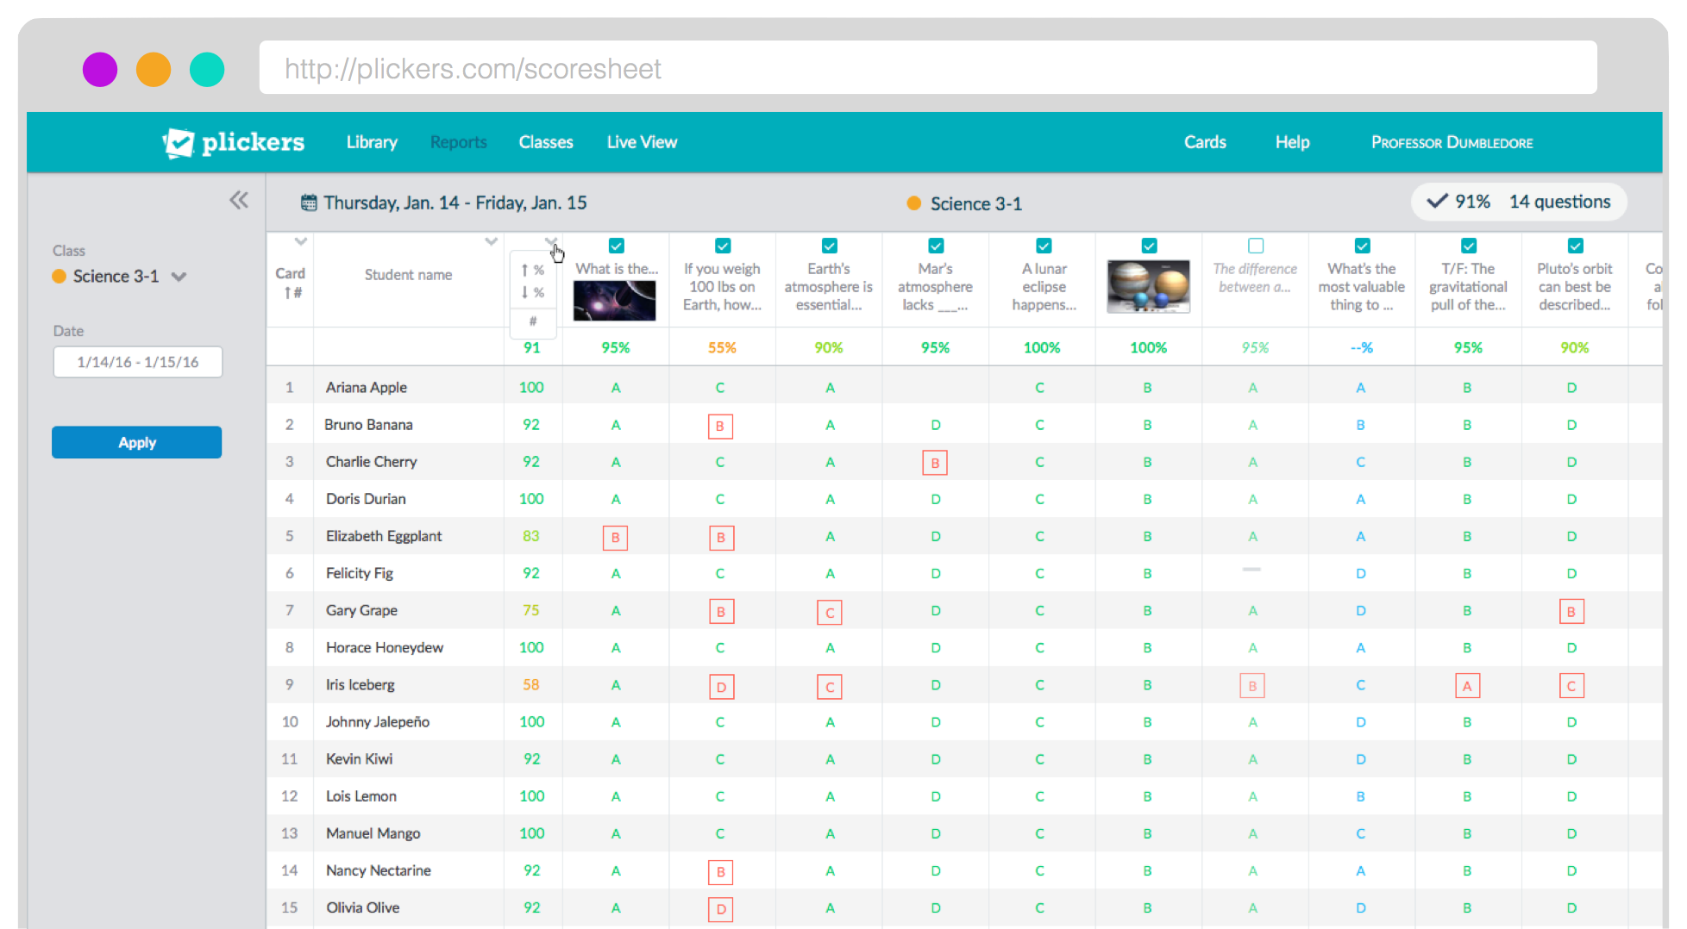
View Results
Use Scoresheet to monitor student progress and save time grading. Question History shows you your latest results.
Select the date range and questions for your Scoresheet and hit apply to see total results for your students, questions, and class.

Slide 8
Resources
http://plickers.com/help
help@plickers.com
Twitter - @plickers
http://plickers.com/presenters
Suggestions - https://plickers.uservoice.com/

